Slide 1

Learning Imbalanced Data with Random Forests
University of Nebraska Omaha
Ali and Paulami
October 29th

Slide 2
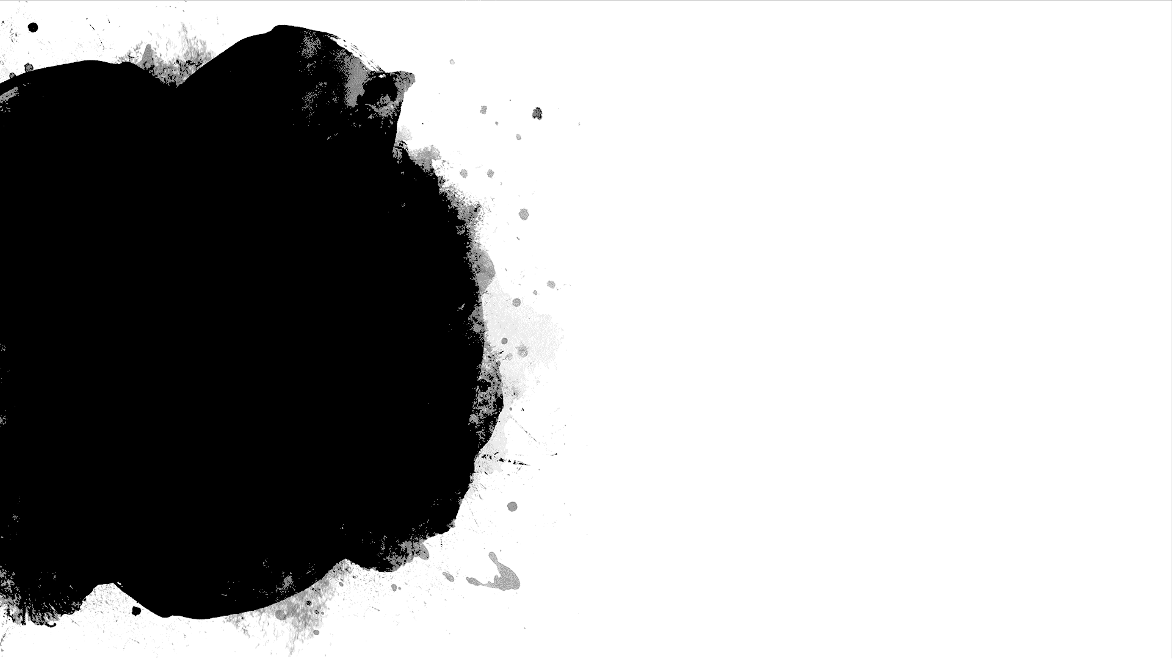
Outline
Imbalanced data
• Common approaches and recent works
• “Balanced” random forests
• “Weighted” random forests
•Performance Metrics
Model evaluation and results

Slide 3
Imbalance Data
Occurs where there is a large discrepancy between the number of examples with each class label.
Standard accuracy no longer reliably measures performance, which makes model training much trickier.
Tends to bias performance towards the majority class.

Slide 4
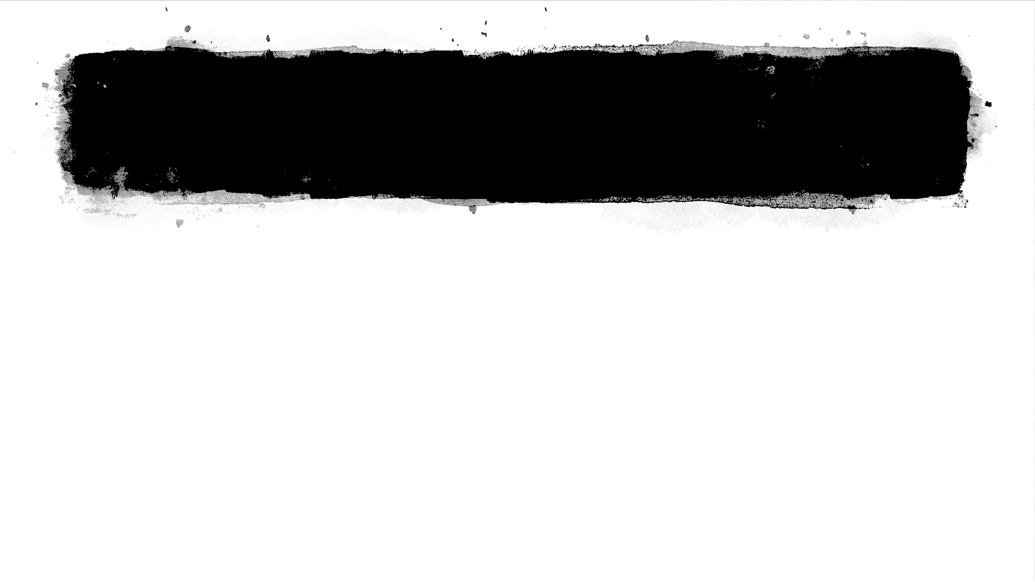
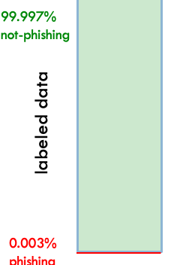
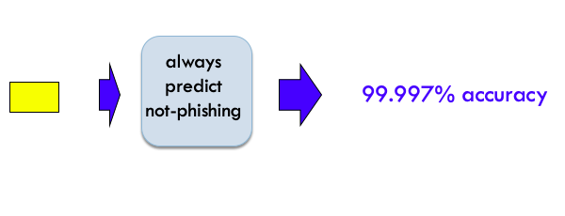
for 1 hour, google collects 1M e-mails randomly for our 1M example dataset only about 30 would actually represent phishing e-mails

Slide 5
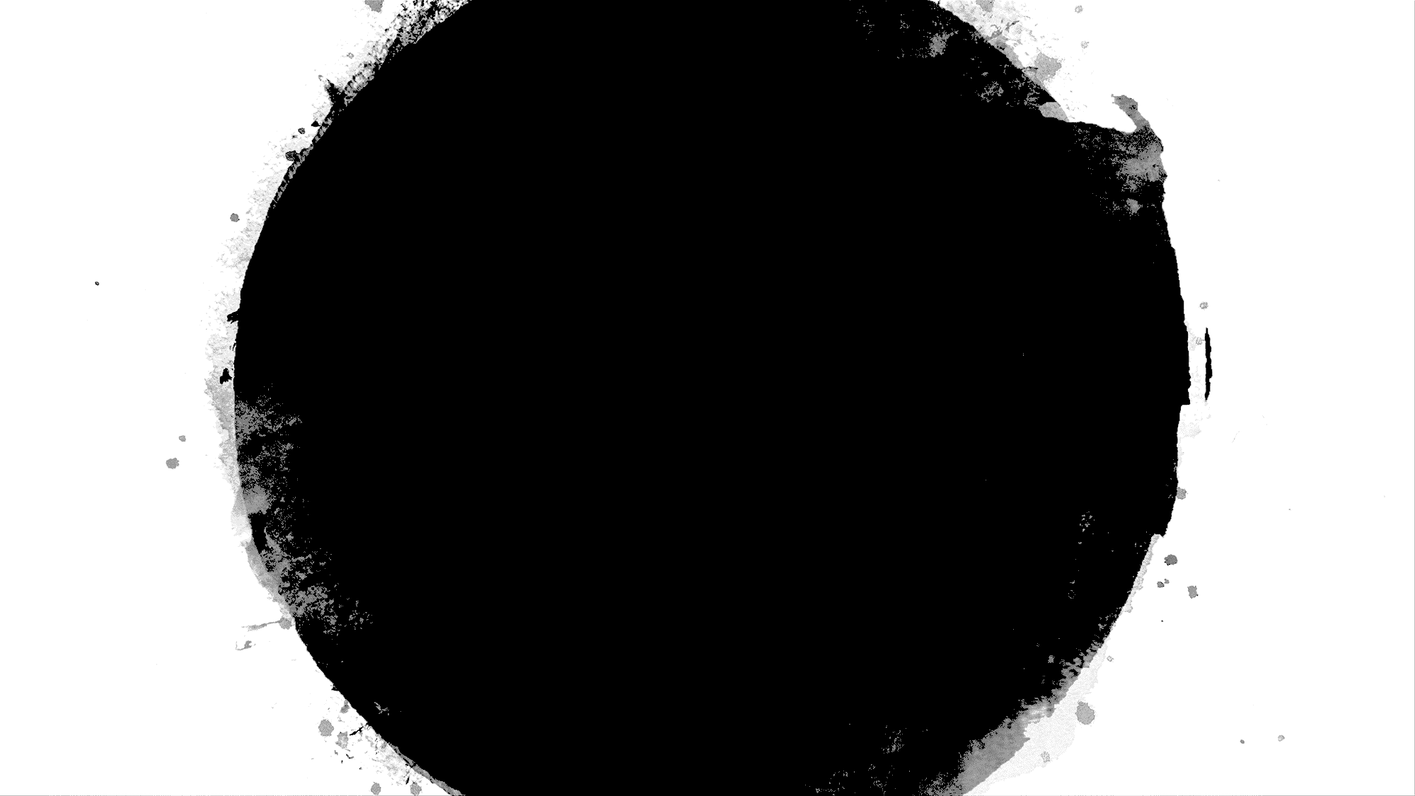
Potential Domains
Class imbalance is prevalent in many applications: fraud/intrusion detection, risk management, text classification, medical diagnosis/monitoring, etc.
Standard classifiers tend to be overwhelmed by the large classes and ignore the small ones,
i.e., tend to produce high predictive accuracy over the majority class, but poor predictive accuracy over the minority class

Slide 6
Common Approaches
At the data level (re-samplings)
Over- sampling: increases the number of minority instances by over-sampling them
Under-sampling: extract a smaller set of majority instances while preserving all the minority instances
At the algorithmic level
Cost-sensitive based: build misclassification cost into the algorithm

Slide 7
Various Methods (before 2004)
RIPPER: Repeated Incremental Pruning to Produce Error Reduction
• SMOTE: Synthetic Minority Oversampling TEchnique (Chawla et al, 2002)
SMOTEBoost

Slide 8
RIPPER
The sequential covering algorithm for two classes (one positive, one negative) works like this: - Start with an empty list of rules (r list). Learn a rule r. - While the list of rules is below a certain quality threshold (or positive examples are not yet covered): Add rule r to r list. Remove all data points covered by rule r. Learn another rule on the remaining data. - Return the decision list.

Slide 9
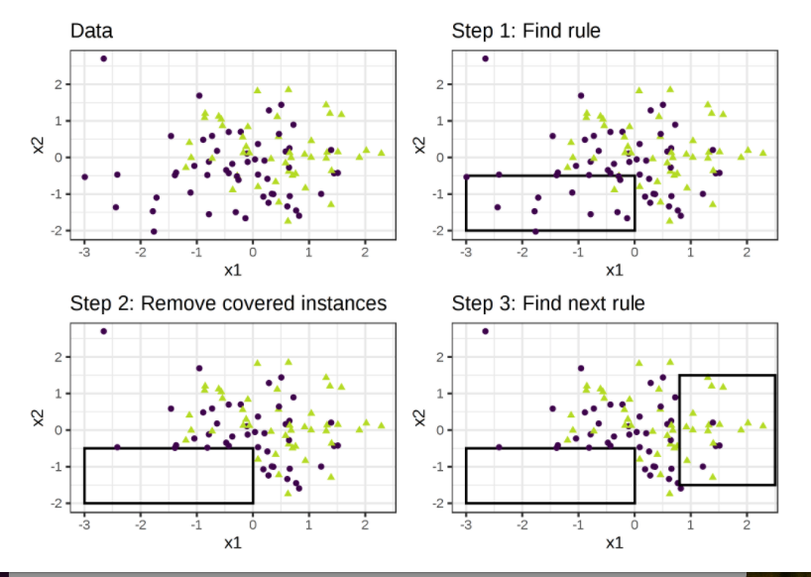
RIPPER

Slide 10
SMOTE
SMOTE: Synthetic Minority Over-sampling Technique
The minority class is over-sampled by taking each minority class sample and introducing synthetic examples along the line segments joining any/all of the k minority class nearest neighbors.
Over-sampling by duplicating the minority examples

Slide 11

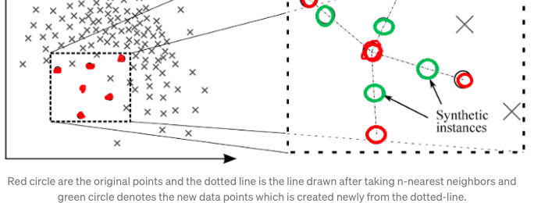
SMOTE

Slide 12
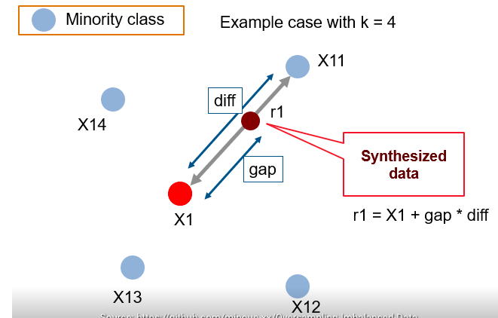
SMOTE

Slide 13
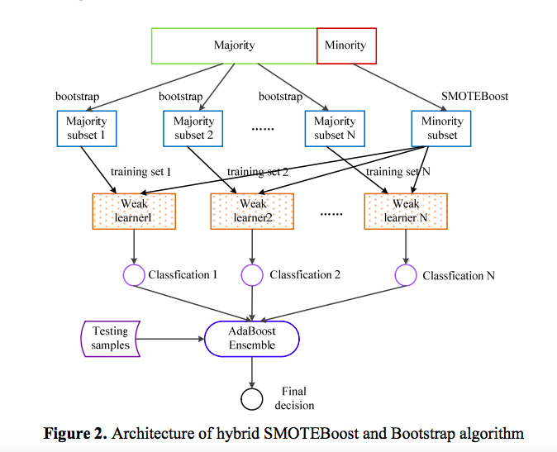
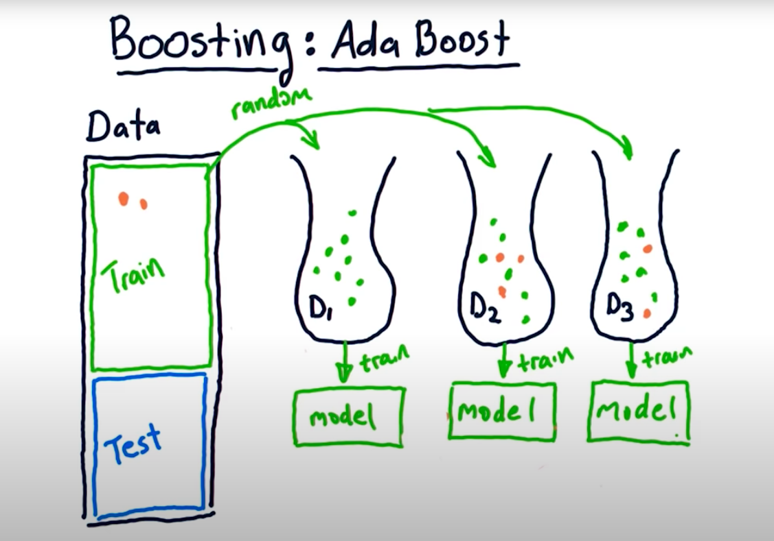
SMOTEBoost

Slide 15
RANDOM FORESTS
A supervised learning algorithm, constructed by combining multiple decision trees (Breiman, 2001)
Draw a bootstrap sample of the data
Grow an un-pruned tree
– At each node, only a small, random subset of predictor variables are tried to split that node
Repeat as many times as you’d like
Make predictions using all trees

Slide 16
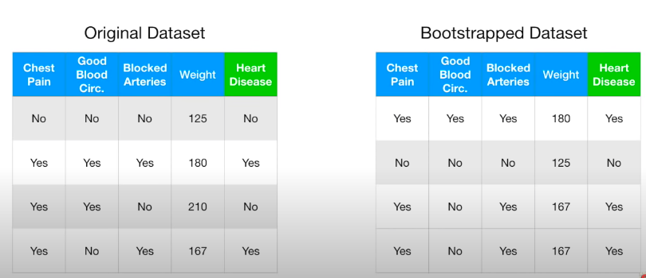
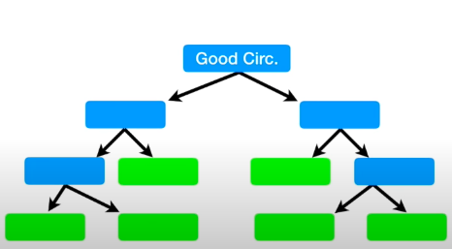
RANDOM FORESTS

Slide 17
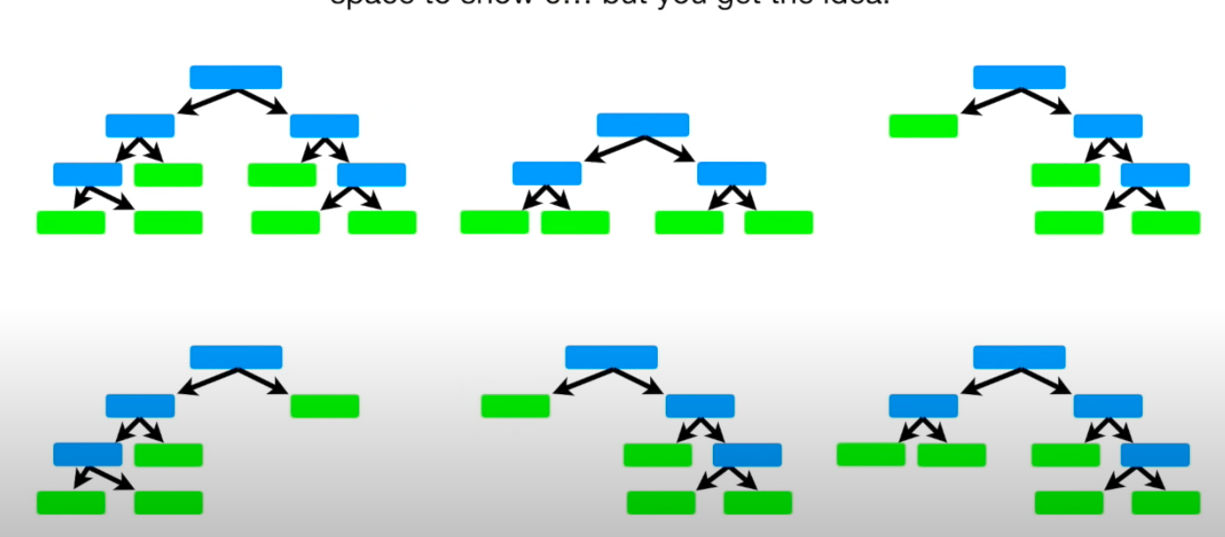
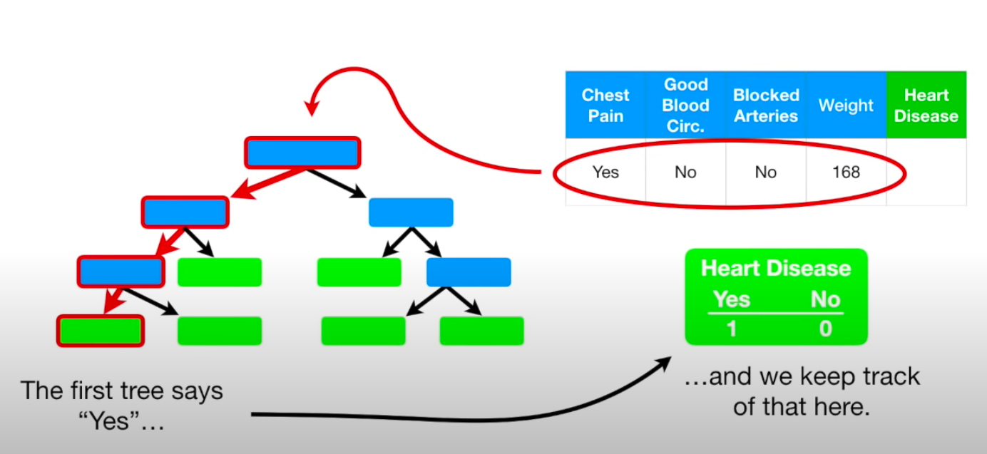
RANDOM FORESTS

Slide 18
BALANCED RANDOM FORESTS (BRF)
Natural integration of down-sampling majority class and ensemble learning.
• For each tree in RF, down-sample the majority class to the same size as the minority class
Given enough trees, all training data are used, so no loss of information.Computationally efficient, since each tree only sees a small sample.

Slide 19
Tuning to create BRF
1. Cut-off:
Each tree gives a classification for each observation, which counts as a vote for the classification.
By aggregating the votes from all the trees, RF decides the winning class as the one having the most votes for the observation.
The cut-off, which is 0.5 by default when there are two classes, is used to adjust the votes.
For example: suppose an observation has 209 votes for the first class and only 92 votes for the second class. If the default cut-off is used, the winning class is decided by comparing 209/0.5 = 408 to 92/0.5 = 184. Since 408 is greater than 194, the winning class is the first class. If a higher cut-off is used, say 0.7, then 209/0.7 = 298.6 is compared to 92/(1 − 0.7) = 306.67 and the winning class is the second class.
2. Sample size:
In the Random Forest, when each tree is fitted to a bootstrap sample of the original training dataset, a class imbalance leads to there being only a small number of the minority class in the bootstrap sample, which results in poor predicting performance for the minority class (poor sensitivity). To alleviate this problem, the number of samples drawn from each class in RF can be tuned so that they are equal, which forces the classes to be balanced
The numbers of samples drawn from the majority and minority classes are both set to the sample size of the minority class in the original dataset.

Slide 20
Weighted Random Forests (WRF)
Incorporate class weights in several places of the RF algorithm: Weighted Gini for split selection.
Class-weighted votes at terminal nodes for node class.
Weighted votes over all trees, using average weights at terminal node.
Using weighted Gini alone isn’t sufficient.

Slide 21
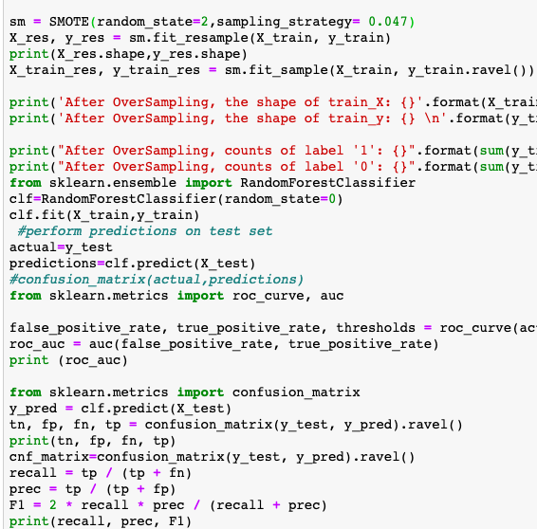
SMOTE

Slide 23
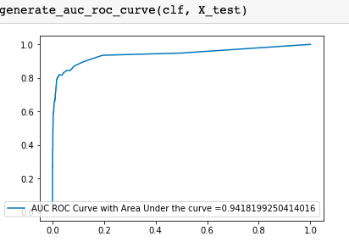
SMOTE ROC

Slide 24
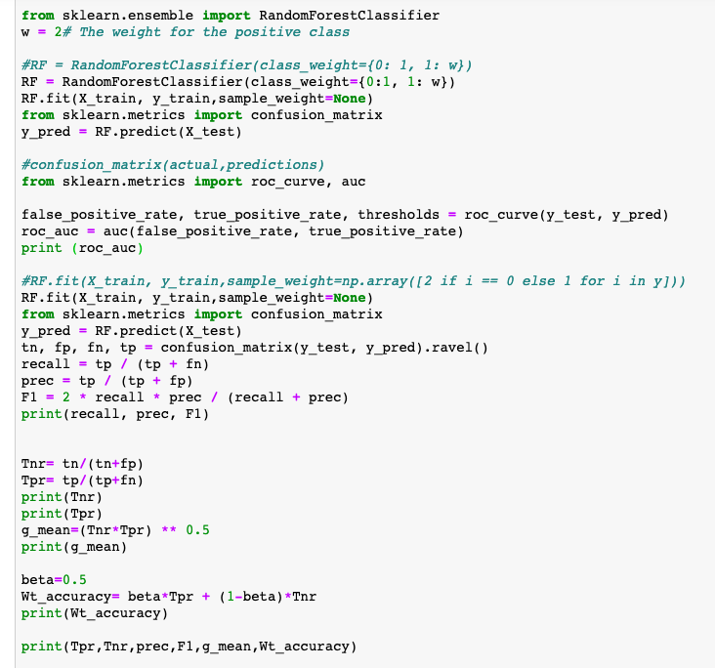
PYTHON SKLEARN PACKAGE IS USED

Slide 25
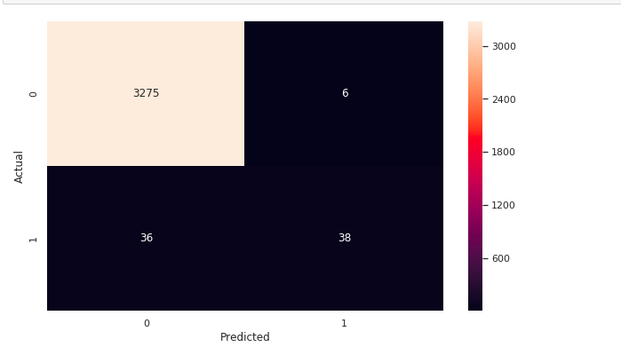
WEIGHTED RANDOM FOREST CONFUSION MATRIX

Slide 26
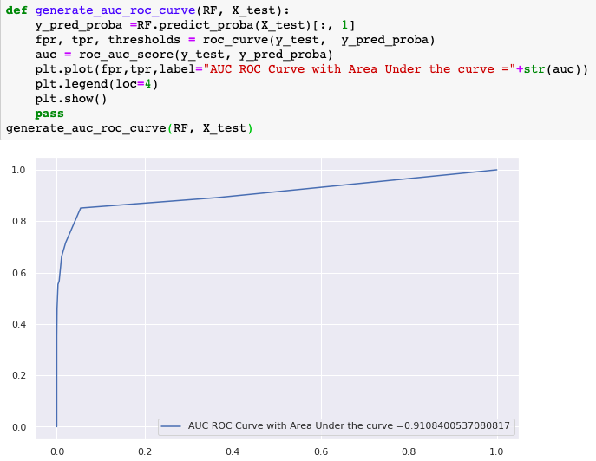
ROC curve WRF

Slide 27
Part of the problem: evaluation
Accuracy is not the right measure of classifier performance in these domains
Other ideas for evaluation measures?

Slide 28
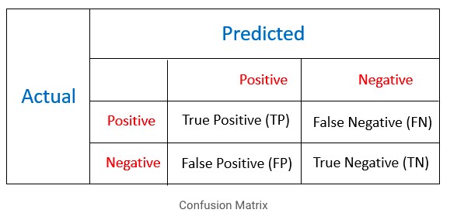
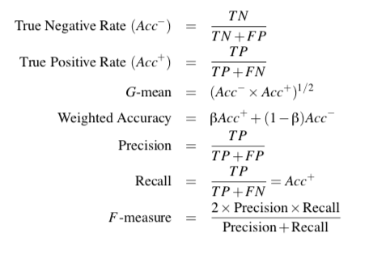
Performance Metrics

Slide 29
“identification” tasks
Precision: proportion of test examples predicted as positive that are correct
Recall: proportion of test examples labeled as positive that are correct
# correctly predicted as positive
# examples predicted as positive
# correctly predicted as positive
# positive examples in test set
predicted
positive
all positive
precision
recall

Slide 30
precision and recall
data
label
predicted
# correctly predicted as positive
precision =
0
0
# examples predicted as positive
0
1
# correctly predicted as positive
recall =
1
0
# positive examples in test set
1
1
2
0
1
precision =
4
1
1
2
recall =
0
0
3

Slide 31
precision and recall
data
label
predicted
# correctly predicted as positive
precision =
0
0
# examples predicted as positive
0
1
# correctly predicted as positive
recall =
1
0
# positive examples in test set
1
1
0
1
Why do we have both measures?
How can we maximize precision?
How can we maximize recall?
1
1
0
0

Slide 32
Maximizing precision
data
label
predicted
# correctly predicted as positive
precision =
0
0
# examples predicted as positive
0
0
# correctly predicted as positive
recall =
1
0
# positive examples in test set
1
0
0
0
Don’t predict anything as positive!
1
0
0
0

Slide 33
Maximizing recall
data
label
predicted
# correctly predicted as positive
precision =
0
1
# examples predicted as positive
0
1
# correctly predicted as positive
recall =
1
1
# positive examples in test set
1
1
0
1
Predict everything as positive!
1
1
0
1

Slide 34
F-measure: (2×Precision×Recall) / (Precision + Recall)
Combined measure that assesses precision/recall tradeoff is F measure (weighted harmonic mean):
Why harmonic mean? Why not normal mean (i.e. average)?

Slide 35
F₁ and other averages
Harmonic mean encourages precision/recall values that are similar!

Slide 36
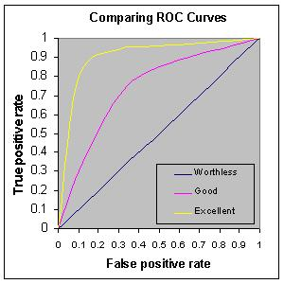
Receiver Operating Characteristic Methodology

Slide 37
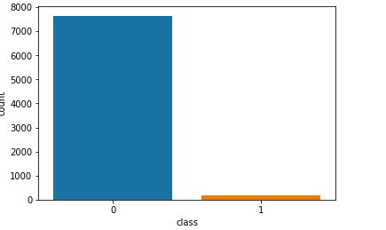
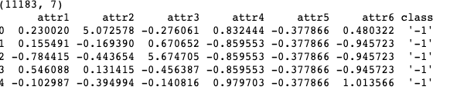
Mammography Data
(11183, 7)
Class='-1', Count=10923, Percentage=97.675%
Class='1', Count=260, Percentage=2.325%

Slide 38
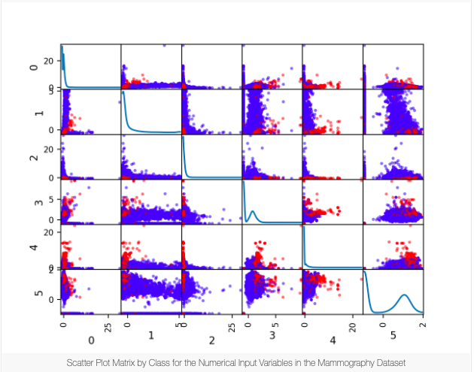
ASSESSMENT

Slide 39

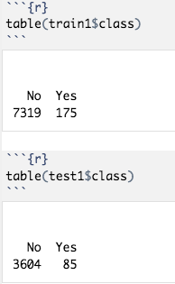
SIMULATION

Slide 40

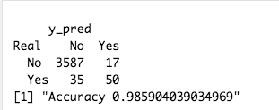
RIPPER Method
Standard_Ripper | 48.12 | 99.61 | 74.68 | 58.11 | 69.23 | 73.87

Slide 41
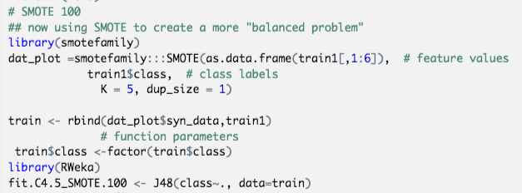
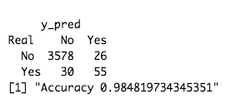
SMOTE Simulation - 100
SMOTE 100 | 58.04 | 99.26 | 64.96 | 61.31 | 75.90 | 78.65

Slide 42
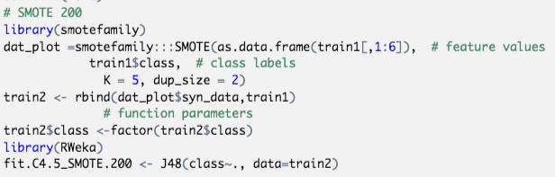
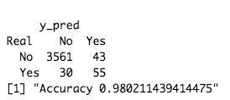
SMOTE Simulation - 200

Slide 43
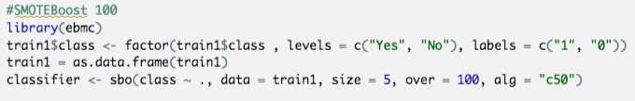
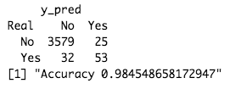
SMOTE BOOST SIMULATION - 100

Slide 44
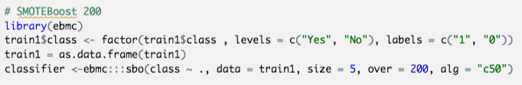
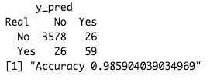
SMOTE BOOST SIMULATION - 200

Slide 45
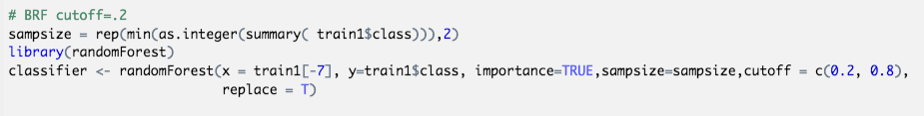
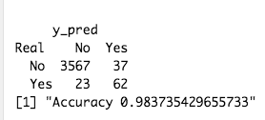
BRF cutoff=.2
BRF cutoff=.2 | 70.00 | 98.98 | 62.12 | 65.83 | 83.24 | 84.49

Slide 46
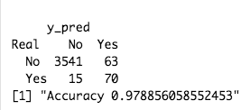
BRF cutoff=.3
BRF cutoff=.3 | 76.54 | 98.21 | 50.51 | 60.86 | 86.70 | 87.38

Slide 47
WEIGHTED RANDOM FORESTS SIMULATION

Slide 48
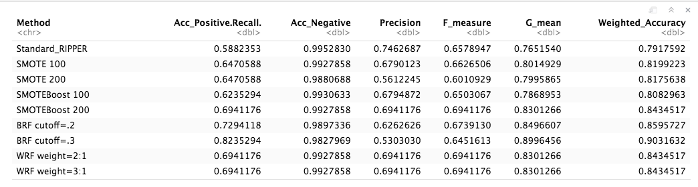
COMPARISON
PAPER RESULTS
Method | Acc_Positive | Acc_Negative | Precision | F_measure | G_mean | Weighted Accuracy
Standard_Ripper | 48.12 | 99.61 | 74.68 | 58.11 | 69.23 | 73.87
SMOTE 100 | 58.04 | 99.26 | 64.96 | 61.31 | 75.90 | 78.65
SMOTE 200 | 62.16 | 99.04 | 60.53 | 60.45 | 78.46 | 80.58
SMOTE BOOST 100 | 61.73 | 99.54 | 76.59 | 68.36 | 78.39 | 80.63
SMOTEBOOST 200 | 62.63 | 99.50 | 74.54 | 68.07 | 78.94 | 81.07
BRF cutoff=.2 | 70.00 | 98.98 | 62.12 | 65.83 | 83.24 | 84.49
BRF cutoff=.3 | 76.54 | 98.21 | 50.51 | 60.86 | 86.70 | 87.38
WRF weight=2:1 | 65.38 | 99.57 | 78.34 | 71.28 | 80.68 | 82.48
WRF weight =3:1 | 72.69 | 99.25 | 69.74 | 71.18 | 84.94 | 85.97
OUR RESULTS

Slide 49
SIMULATION RESULTS FROM PYTHON
METHOD | TPR | TNR | PRECISION | F1 | G_MEAN | WT.ACCURACY
SMOTE 100 | 50.64 | 99.81 | 86.66 | 63.93 | 71.10 | 75.23
WRF 2:1 | 52.72 | 99.78 | 84.78 | 64.99 | 72.51 | 76.24
WRF 3:1 | 52.70 | 99.90 | 92.85 | 67.24 | 72.56 | 76.30
SMOTE 100 AND 200 GIVING THE SAME RESULTS IN PYTHON

Slide 50
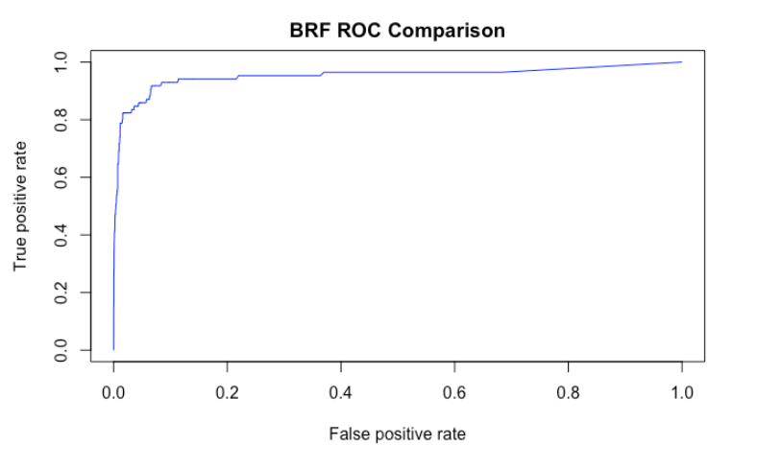
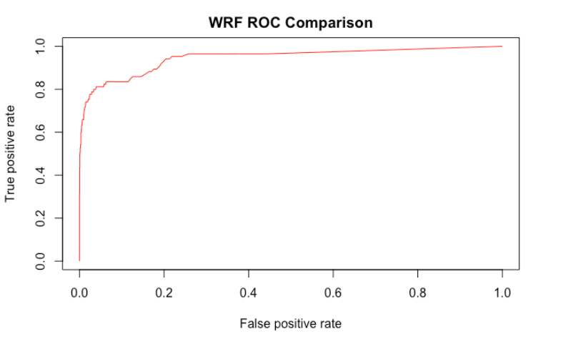
ROC Comparison

Slide 51
The paper proposed two methods of learning imbalanced data with random forests
BRF: down-sampling majority in each tree
WRF: incorporate class weights in several places
From the simulation and the results,
• Both show improvements over existing methods
• The two are about equally effective on real;
From our simulation results!
BRF shows improvements over existing methods
WRF (simulation might gone wrong): the method was added to randomforest package that build under R-3.2.1.

